Slide 1

Moosic
Shall
choose Machine Learning?
Almuth
Gian
Liliana
Sarra

Slide 2
Introduction
Goal:
An initial prototype for data-driven playlist creation
Material:
Dataframe of 5000 songs
14 Spotify features
🗝️ Can Spotify's audio features detect similarities between songs based on human perception?
🗝️ Is K-Means the right algorithm, or should other methods be considered?
01 - Welcome everyone and thank you for joining our presentation. Our team of Data Scientists will present to you - A prototype for playlist creation using Data Science.
A tool for you, the playlist creators to have a good starting point and to support your workflow.
02 - What did we work with?
A database of 5000 songs, that we analysed with the help of 14 Spotify features and the machine learning algorithm KMeans.
03 - What did we consider?
We want to Create playlists that are in tune with MOOSIC’s products
- personal playlists with a certain feel to them

Slide 3
Preparation: irrelevant and redundant features
Some features are irrelevant for the cluster analysis
acousticness
tempo
liveness
duration
loudness
valence
danceability
time_signature
energy
id
mode
speechiness
key
type
instrumentalness
html
Notes:
Mention columns, features and html

Slide 4
Preparation: irrelevant and redundant features
Some features are irrelevant for the cluster analysis
Highly correlated features are redundant → PCA
acousticness
tempo
liveness
-0.697709
-0.850469
loudness
valence
0.680097
danceability
PCA
0.786860
energy
instrumentalness
speechiness
PCA

Slide 5
Preparation: irrelevant and redundant features
Some features are irrelevant for the cluster analysis
Highly correlated features are redundant → PCA
tempo
liveness
loudness
danceability
instrumentalness
speechiness

Slide 6
Preparation: irrelevant and redundant features
Some features are irrelevant for the cluster analysis
Highly correlated features are redundant → PCA
tempo
liveness
danceability
loudness
speechiness
instrumentalness

Slide 7
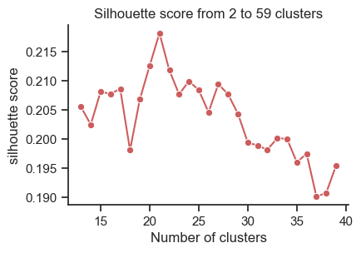
Clustering: seeking the right number
Silhouette (and elbow)

Slide 8
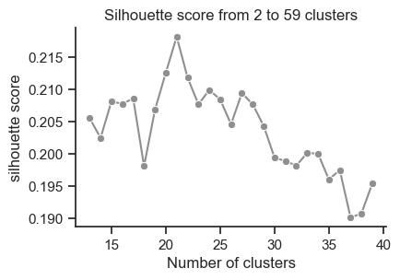
Clustering: seeking the right number
Silhouette (and elbow)
Silhouette is max for $k=21$

Slide 9
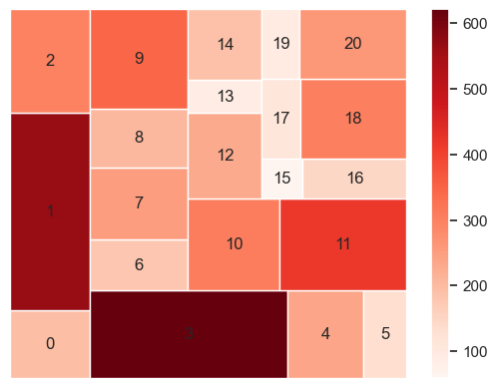

Clustering: exploration
Number of songs per cluster
($k=21$)
47.6% of pairs are very far from each other (pairwise distance>0.8) and 0% are very close (pairwise distance<0.2)
Notes:
Focus on cluster number 2

Slide 10
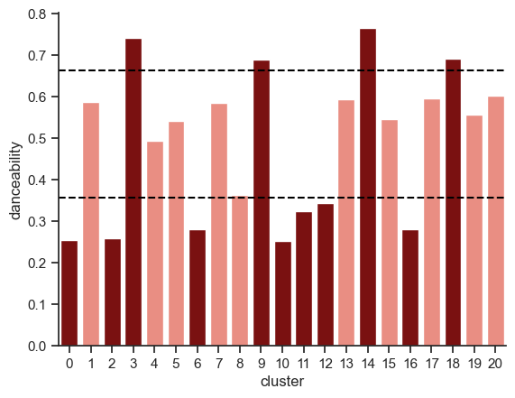

Clustering: exploration
Distribution of individual features across clusters
High feature
($k=21$)
80%
feature
20%
Low feature

Slide 11
Clustering: exploration
Labeling clusters with high (>80%) or low (<20%) value of feature
High danceability
High duration
Low instrum.

Slide 12

Clustering: telling features
Labeling clusters with high (>80%) or low (<20%) value of feature
Labelled clusters
User friendly titles
High danceability
Soothing Instrumental Journeys
High duration
Dynamic Tempo Soundscapes
Low instrum.
Laid-Back Melodic Escapes

Slide 13

Telling features
Labeling clusters with high (>80%) or low (<20%) value of feature
User friendly titles
Soothing Instrumental Journeys
Dynamic Tempo Soundscapes
Laid-Back Melodic Escapes

Slide 14

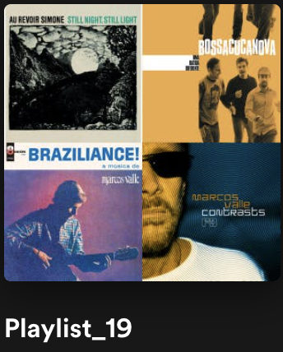
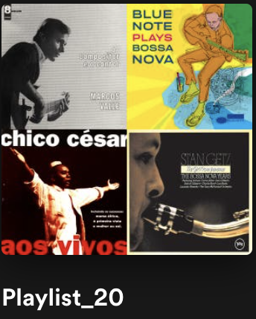
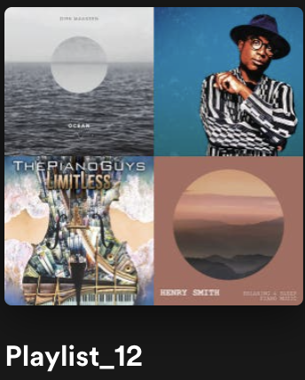
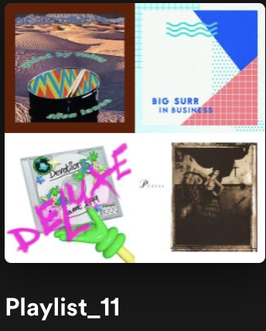
Rating
Create playlist on Spotify via Spotipy API
Rater 1: 0.9
Rater 2 : 0.72
Rater 3 : 0.82
Rater 4 : 0.52
4 raters for 4 groups of playlists
Rate of the agreement from 0 to 1
74%

Slide 15
Concluding remarks
🗝️ 0% clusters very close and ~50% very distant → KMeans-Clustering is overall good
🗝️ Average Rating 74% → the values of the Spotify features is good
Data-driven approach: good basis for playlist creators
Next steps:
Test the playlists among listeners
Try to get cleaner data
Are there other features?
Look into feature engineering

Slide 16
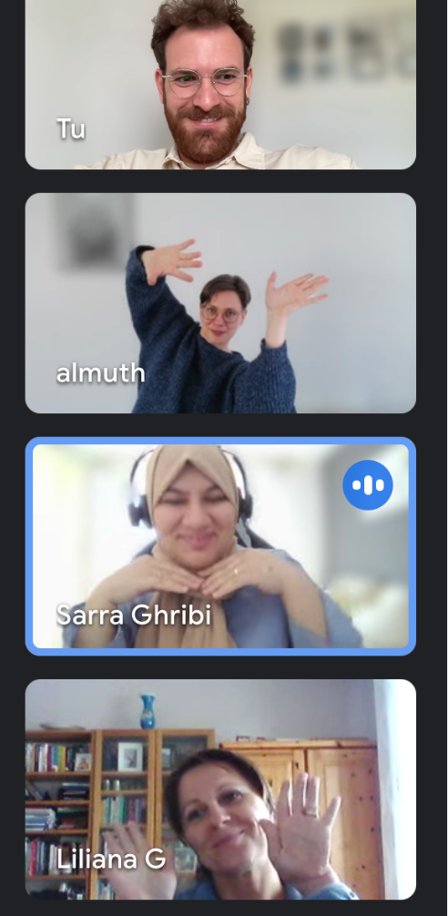
90%
Rater 1
52%
THANK YOU FOR
YOUR ATTENTION
Rater 4
72%
Rater 2
82%
Rater 3

Slide 17
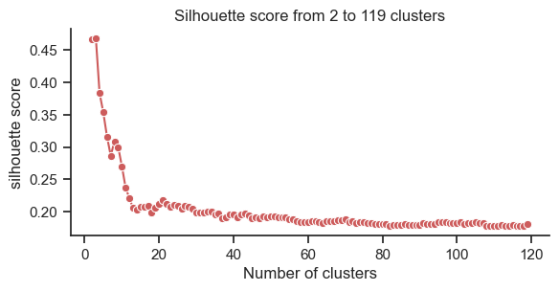
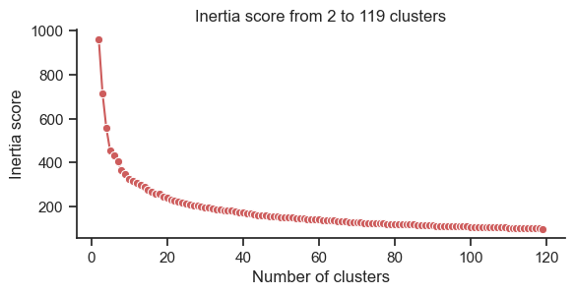

Slide 18
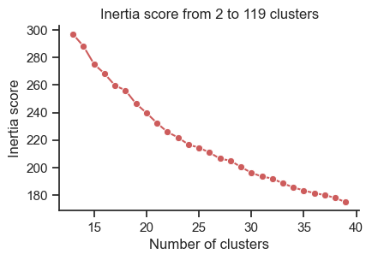

Clustering: seeking the right number
Silhouette and elbow
Silhouette is max for $k=21$
Elbow behavior of inertia for $k=21$

Slide 19
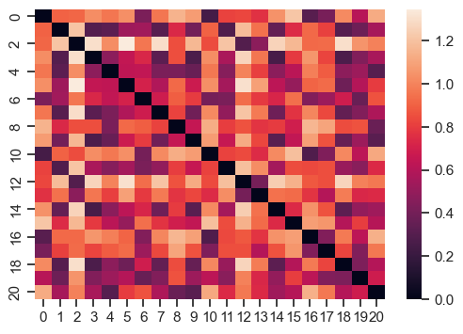

Slide 20
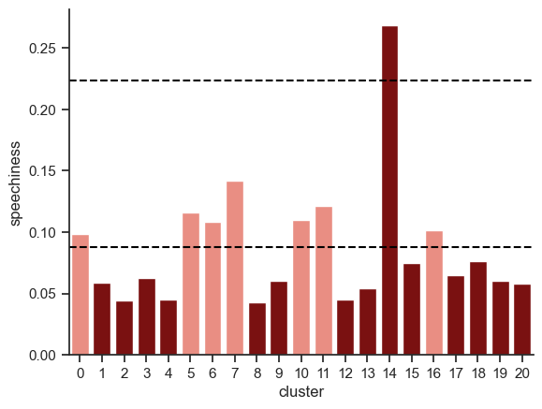
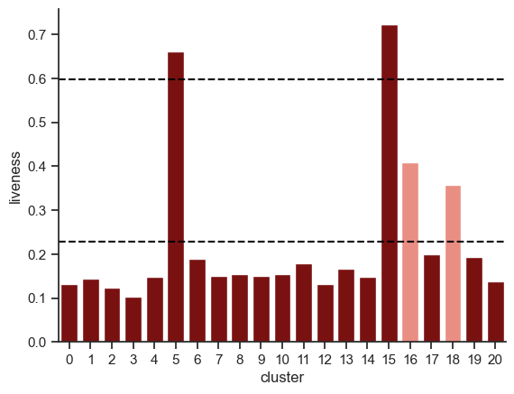
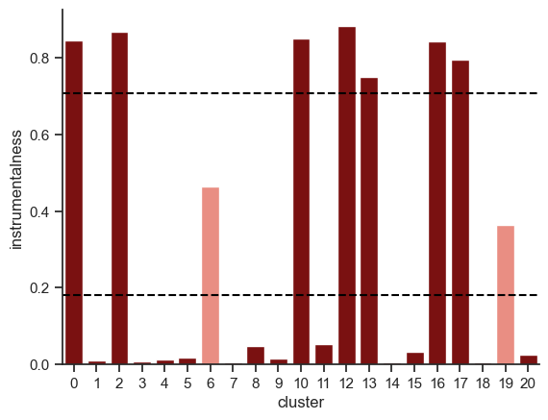
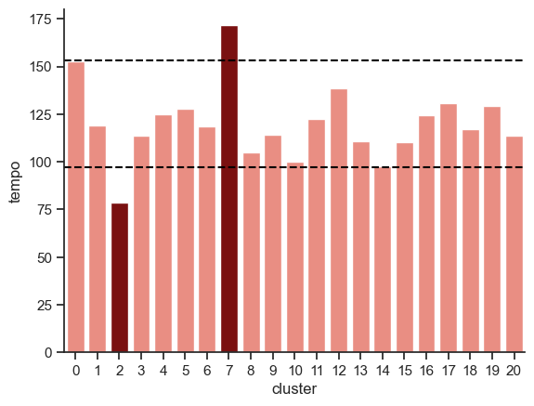
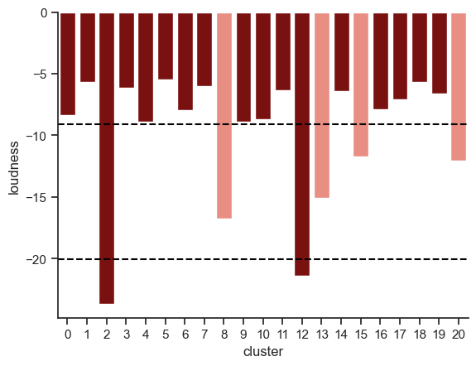

Slide 21
Telling features
Labeling clusters with high (>80%) or low (<20%) value of feature
Labelled clusters
User friendly titles
High danceability
Soothing Instrumental Journeys
High duration
Dynamic Tempo Soundscapes
Low instrum.
Laid-Back Melodic Escapes

Slide 22
Case study
5k something songs.
Goals and key questions
Need for clusters (scatter plots)
Relevant features (correlations and PCA) (G)
The clusters
Number of clusters
Elbow and silhouette
Exploration
treemap plots for populations,
(Heatmap)
Giving names with telling features and chatGPT
SpotyPy
Our agreement
Final remarks (A/B testing?)

Slide 23
Can Spotify's audio features detect similarities between songs based on human perception?
Is K-Means the right algorithm, or should other methods be considered?

